Slide 1
CS 4310: Software Engineering
Lecture 6
Data Flow Modeling

Slide 2
Data Flow Model
Based on the notion that systems can be modelled as a set of interacting functions
Uses data-flow diagrams (DFDs) to graphically represent the external entities, processes, data-flow, and data stores
A graphical system model that shows all of the main requirements for an information system: inputs, outputs, processes and data storage

Slide 3
Diagram Symbols
DFDs are composed of four main elements:
  Data flow
  Process (bubble)
  Data store
  Terminators
Name(s)
#
Name
Name
Name

Slide 4
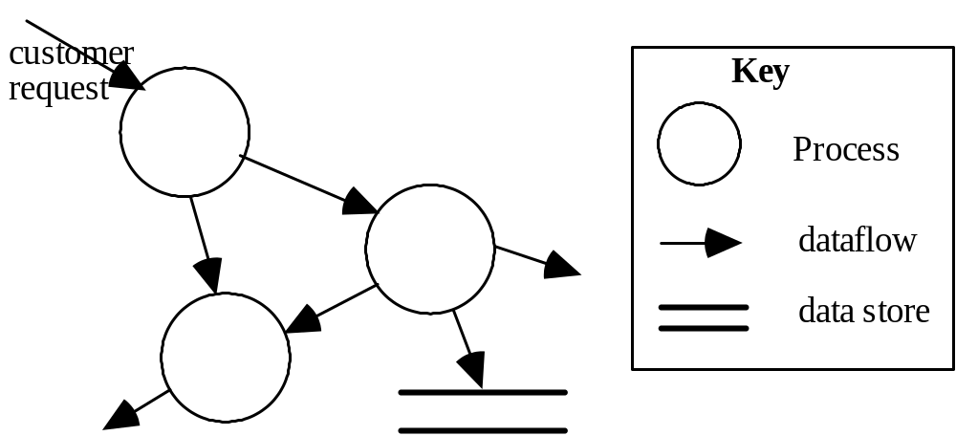
DFD Connections

Slide 5
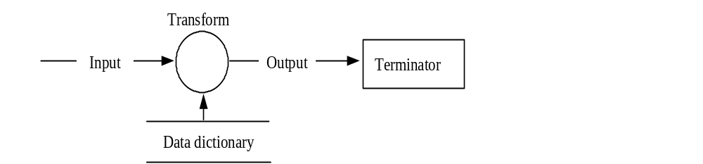
Example of Flows

Slide 6
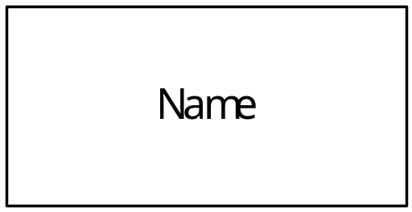
The Terminator Symbol
A Terminator is an external entity with which the program system communicates.
Typically, a terminator is a person or a group of people, an outside organization, or government agency.

Slide 7
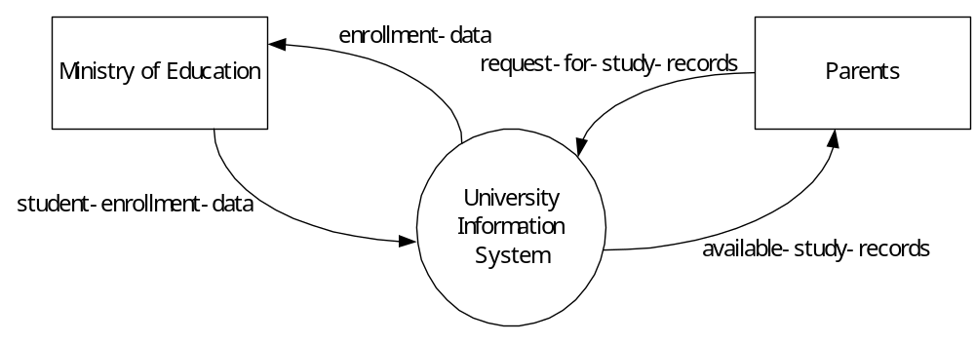
Example of Terminators

Slide 8
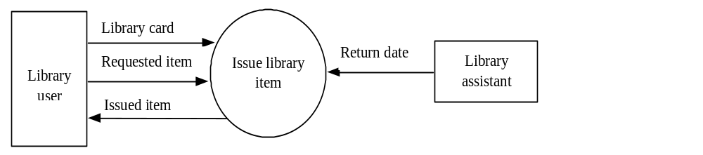
Example: Library System

Slide 9
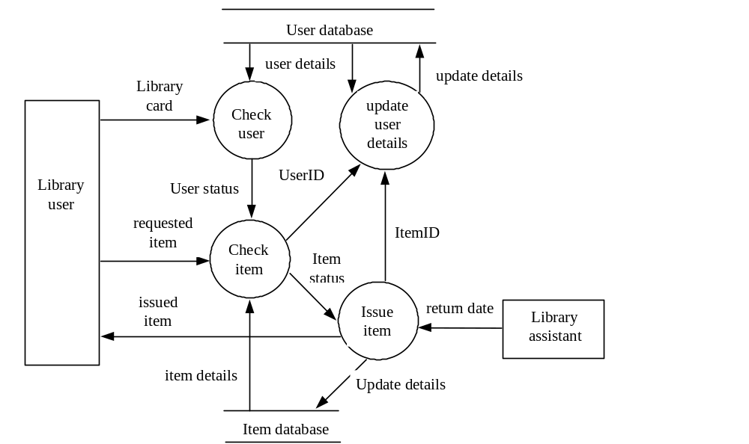
Example: Library System

Slide 10
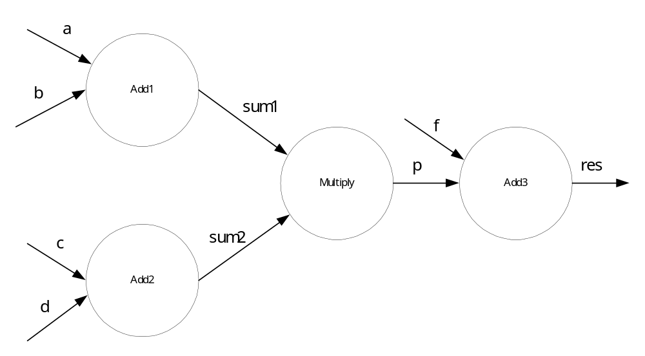
The data flow diagram for evaluating the arithmetic expression: (a + b) * (c + d) + f
Example: Simple Math Problem

Slide 11
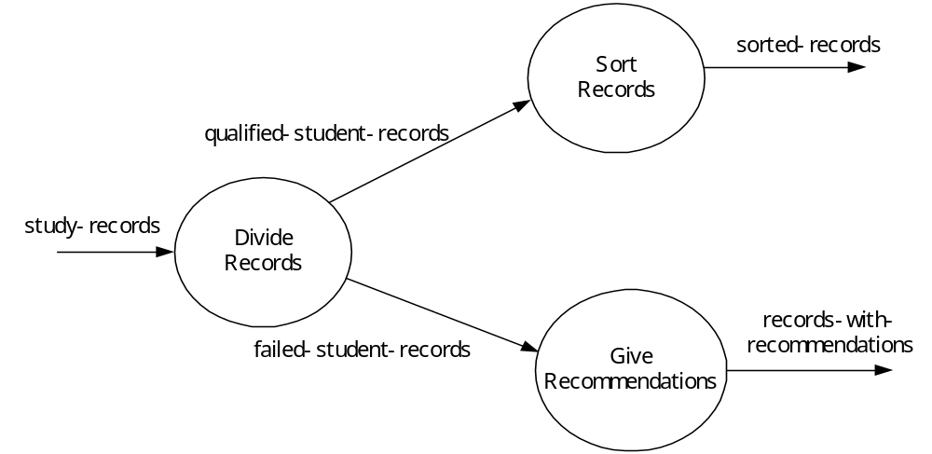
Data Flows
Data flows are usually used together with processes; that is, they are used to connect processes, indicating that data items are moving from one process to another. For example,

Slide 12
Important points about data flows
A data flow should carry one type of information. Do not name a data flow as: student and professor and administrator.
A data flow can carry a composite data item. For example, university-member, which may consists of the three components: student, teacher, and administrator.
Data flows show directions.

Slide 13
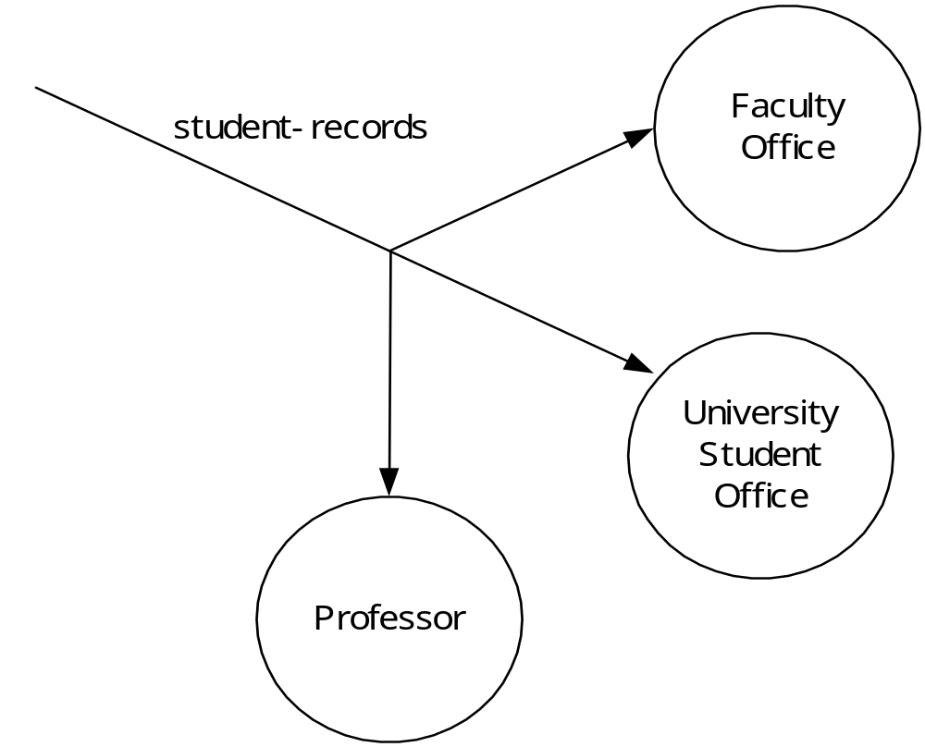
Flow Directions

Slide 14
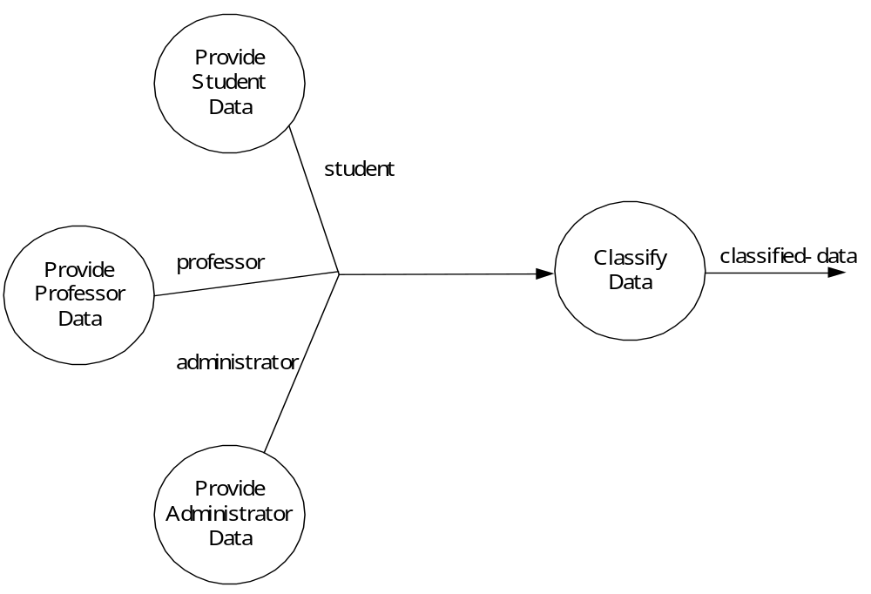
Converging Data Flows

Slide 15
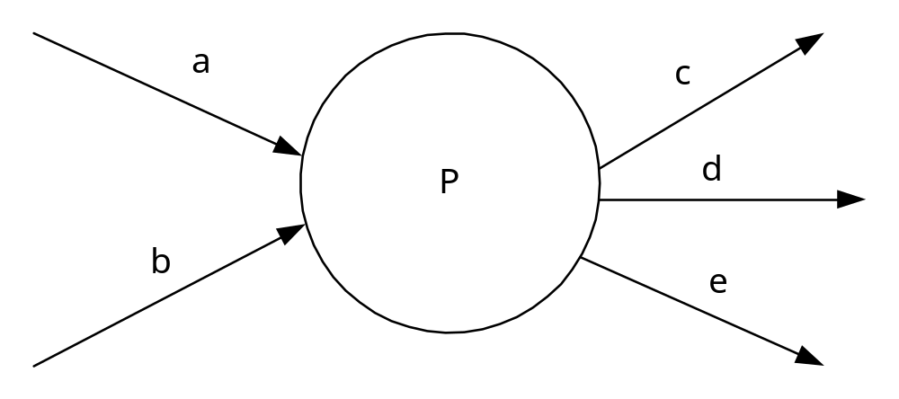
Data and Procedures
Data flows do not answer many procedural questions.

Slide 16
Data Stores
A store describes a single or a set of data items.
For example, a file, database can be modeled as a store.
The graphical representation: one of the following representations can be used:
representation (a) only gives the name of the store, while (b) gives both the name and the number that is used to reference the store in a DFD involving many stores.

Slide 17
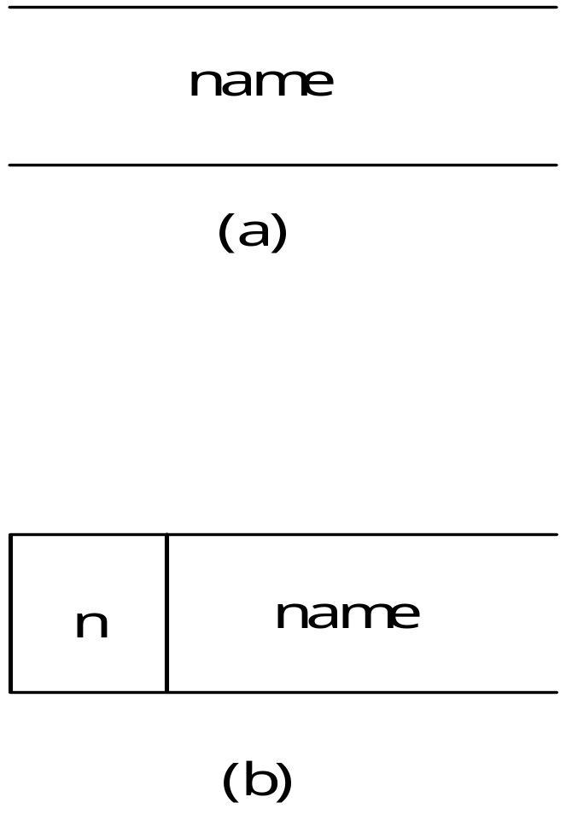
Data Store Symbols

Slide 18
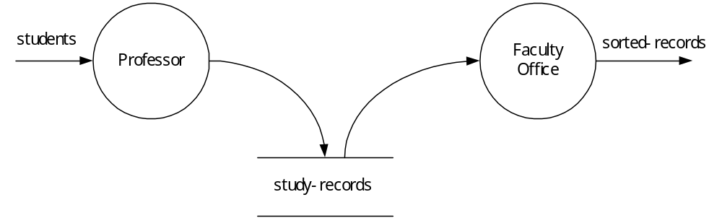
Store Connections
Stores are connected to processes by data flows.
        A data flow to a store from a process: it means a writing or updating of the store.
        A data flow from a store to a process: it means a read of the store by the process.

Slide 19
Example DFD: Context level
Data Flow 1
0
system
Data Flow 6
Source
Data Flow 2
Sink

Slide 20
Example: Lower Level DFD
Data Flow 1
2
Process
Data Flow 6
Data Flow 2
Data Flow 3
Data Flow 5
1
Process
Data Flow 4
Data Store

Slide 21
DFD Creation
Data store
Process
Process
Data
Source
Data
Sink

Slide 22
Data Flows
A process is needed to exchange data flows between external data sources and sinks
A process is needed to update a data store
A process is needed to present data from a data store
A process is needed to move data from one data store to another
process
Source
sink
Source
process
Data store
process
sink
Data store
process
Data store
Data store

Slide 23
Your Project Work
Develop Analysis Document.
Think about your system’s data flows and processes

